Slide 1
New York City Leading Cause of Death
Beza Arega

Slide 2
This dataset shows the leading cause of death in New York between the years 2007-2021.
New York is in the United States. It is considered the busiest city and known for its diversity in race and ethnicity.

Slide 3
The total death count is 2102 in this dataset.
The 6 variables in the dataset to help us better understand the data:
Leading Causes
Gender
Race and Ethnicity
Deaths
Death Rate
Age adjusted death rate

Slide 4
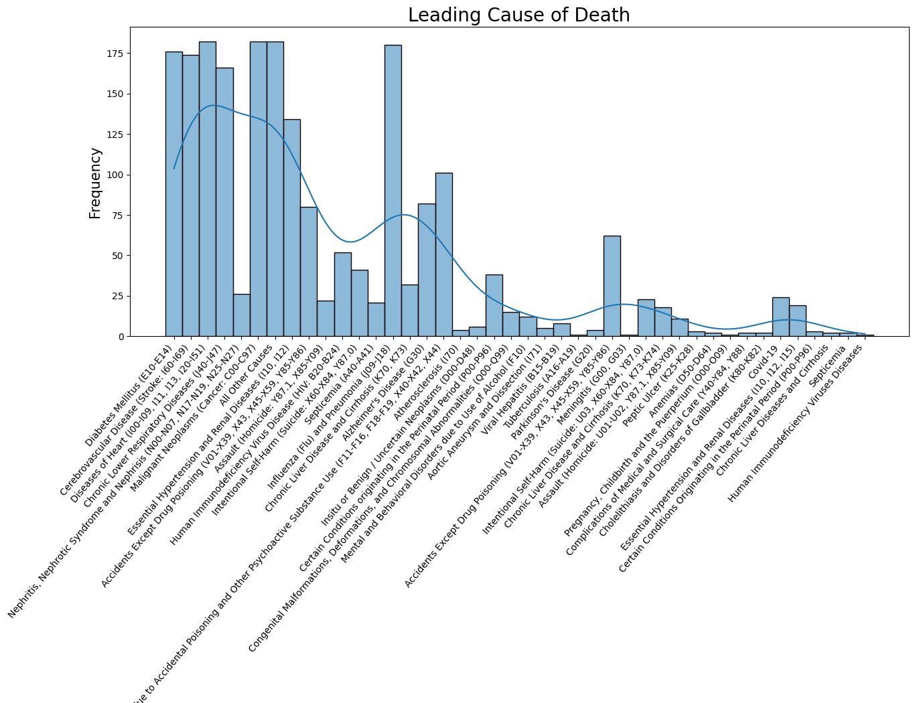
The highest leading cause
The highest leading causes of death in New York were disease of heart, malignant neoplasm (cancer), and influenza and pneumonia.

Slide 5
The lowest leading cause
The lowest leading causes were tuberculosis, meningitis, pregnancy childbirth and the puerperium and human immunodeficiency virus disease.

Slide 6
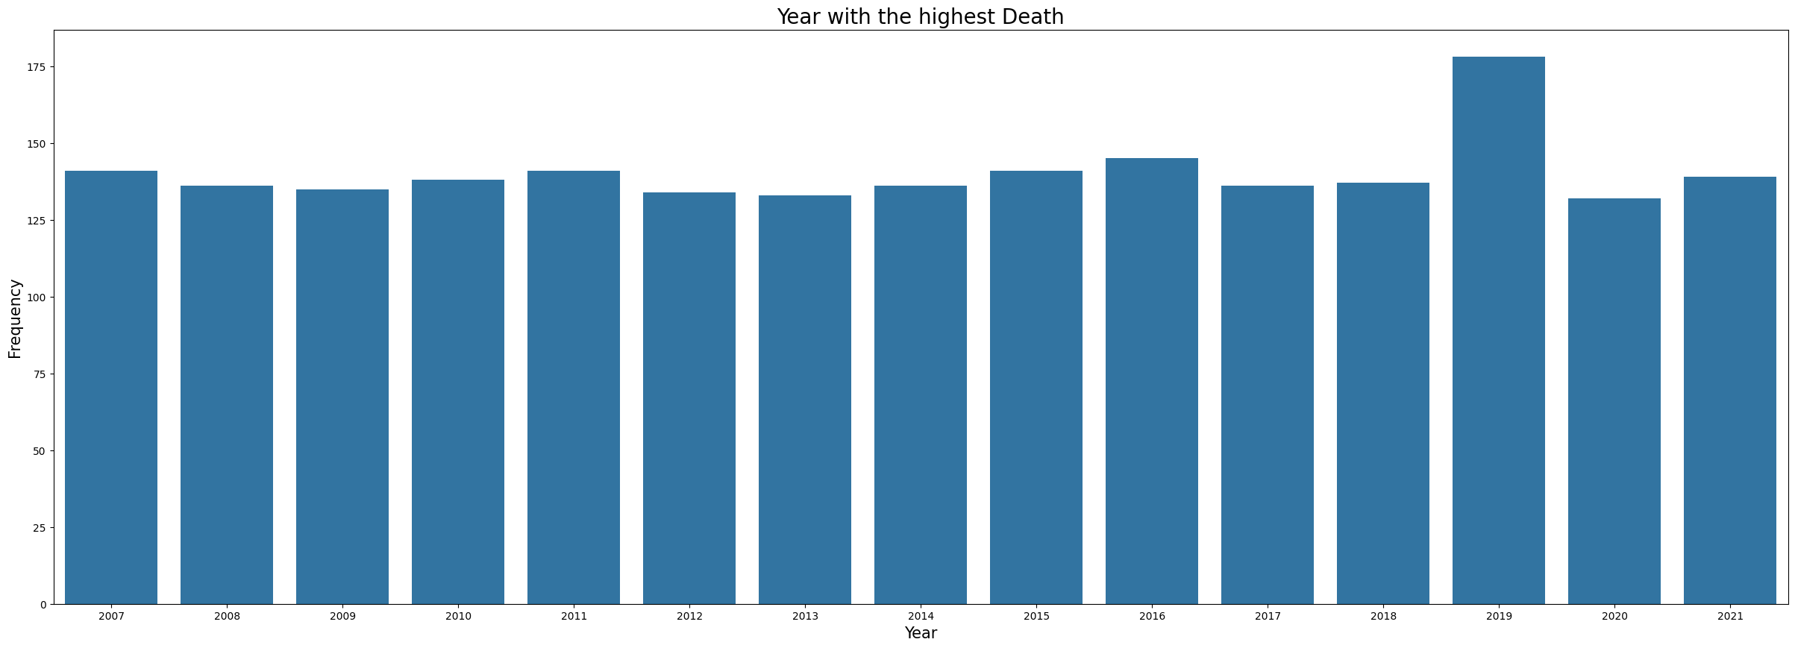
The death rate throughout the years
The death rate seems to be slightly deceasing and increasing throughout the years, but there was a significant increase in 2019.
2019 was the year with the highest death rate.
The lowest death rate was in the years 2013 and 2020.

Slide 7
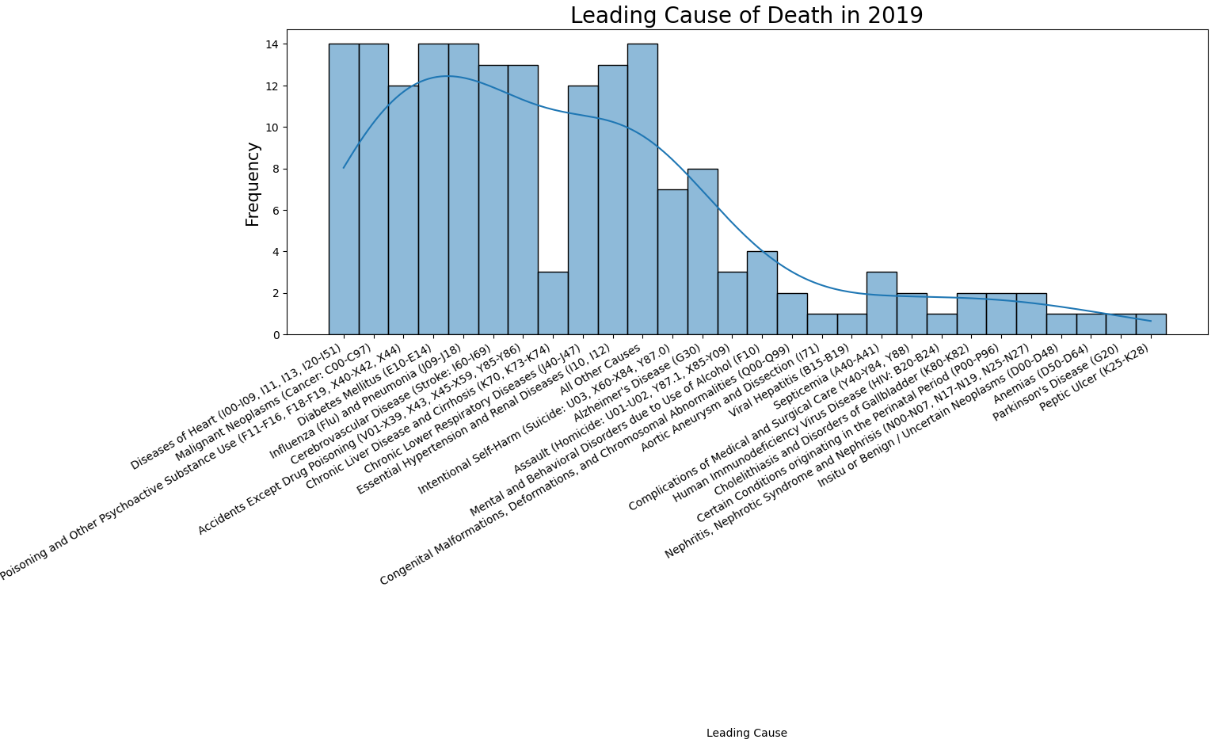
Highest leading cause in 2019
The highest leading causes of death in 2019 were disease of heart, malignant neoplasm (cancer), diabetes mellitus, and influenza and pneumonia.

Slide 8
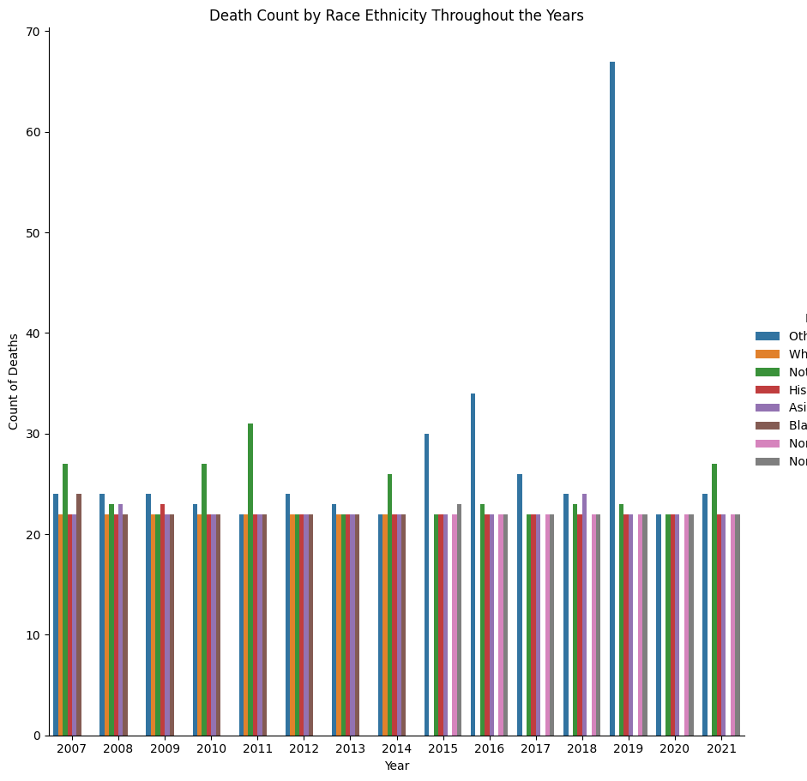
Death rate throughout the years by race and ethnicity
The race & ethnicity of this dataset seems to be equal throughout the years. By looking at the visual, the only outliers are the races & ethnicities that were not mentioned.

Slide 9
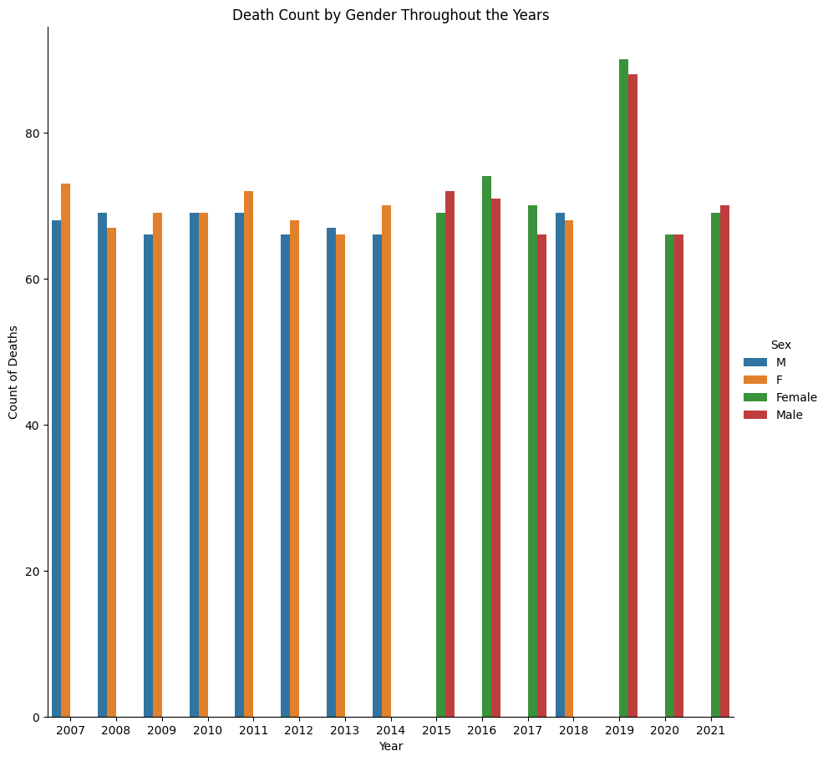
Death rates throughout the years by gender
Throughout the years, females seem to have more deaths than males. There isn't a significant difference between the death counts between the 2 genders, but we can see that the female death count is slightly higher than the males throughout the years.
There are years which the 2 genders are equal like in 2010 and 2019.

Slide 10
Conclusion
This analysis visualized the highest and lowest leading causes of death in New York and the year with the highest and lowest death rate. New York is a very diverse state which is probably why there wasn't any difference in death rates based on race and ethnicity. There was a difference in the rates when it was based on gender, females had a slightly higher death rates than male throughout the years. Using the different visualizations helped to better understand the dataset.

Slide 11
Thank you!

